Slide 1
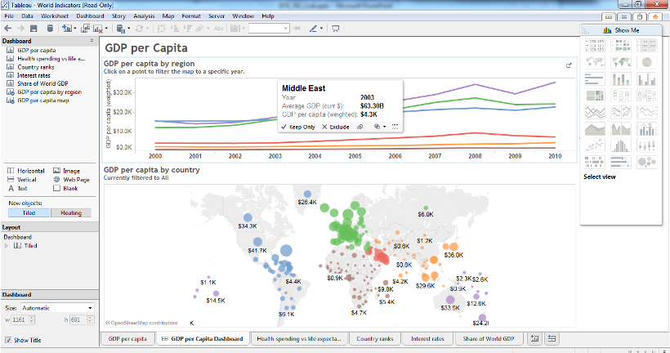
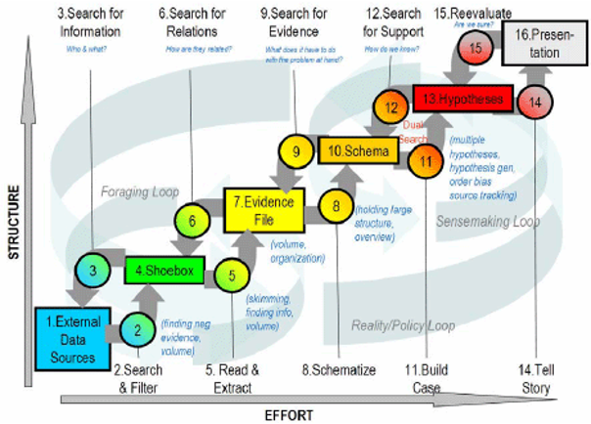
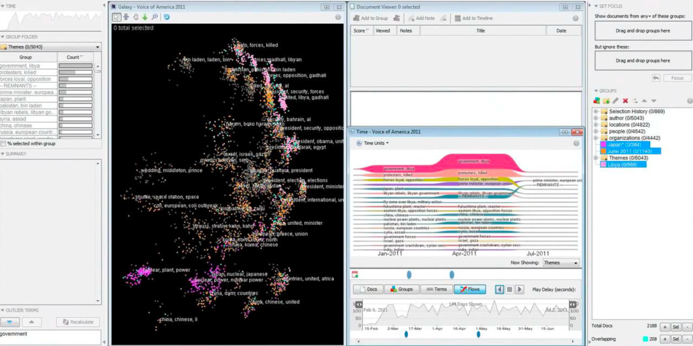

What & Why
Visual Analytics?
ISTE-782
VISUAL ANALYTICS
By Dr.Bilgic

Slide 2
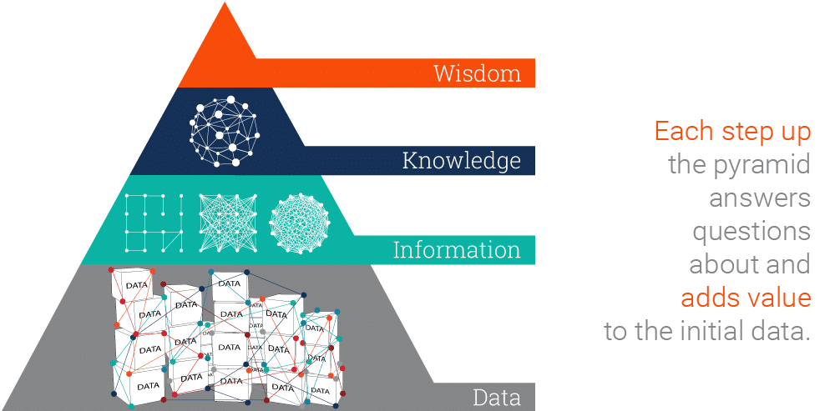
Data, Information, Knowledge, Wisdom (DIKW) Pyramid
Data: Data is a collection of facts in a raw or unorganized form such as numbers or characters.
Information: “cleaned” data to make easier to measure, visualize and analyze for a specific purpose; ‘who’, ‘what’, ‘when’, ‘where’.
Knowledge: “How” is the information, derived from the collected data, relevant to goals? How can we apply the information to achieve goal?
Actionable insight or wisdom: ‘why’ do something’ and ‘what is best’. In other words, wisdom is knowledge applied in action.
Picture credit: ontotext
Notes:
See the source at https://www.ontotext.com/knowledgehub/fundamentals/dikw-pyramid/#:~:text=The%20DIKW%20Pyramid%20represents%20the,and%20adds%20value%20to%20it.
Data: Data is a collection of facts in a raw or unorganized form such as numbers or characters. However, without context, data can mean little.
Information: This is data that has been “cleaned” of errors and further processed in a way that makes it easier to measure, visualize and analyze for a specific purpose. By asking relevant questions about ‘who’, ‘what’, ‘when’, ‘where’, etc., we can derive valuable information from the data and make it more useful for us. But when we get to the question of ‘how’, this is what makes the leap from information to knowledge.
Knowledge: “How” is the information, derived from the collected data, relevant to our goals? “How” are the pieces of this information connected to other pieces to add more meaning and value? And, maybe most importantly, “how” can we apply the information to achieve our goal?
Actionable insight or wisdom: We must answer questions such as ‘why do something’ and ‘what is best’. In other words, wisdom is knowledge applied in action.

Slide 3
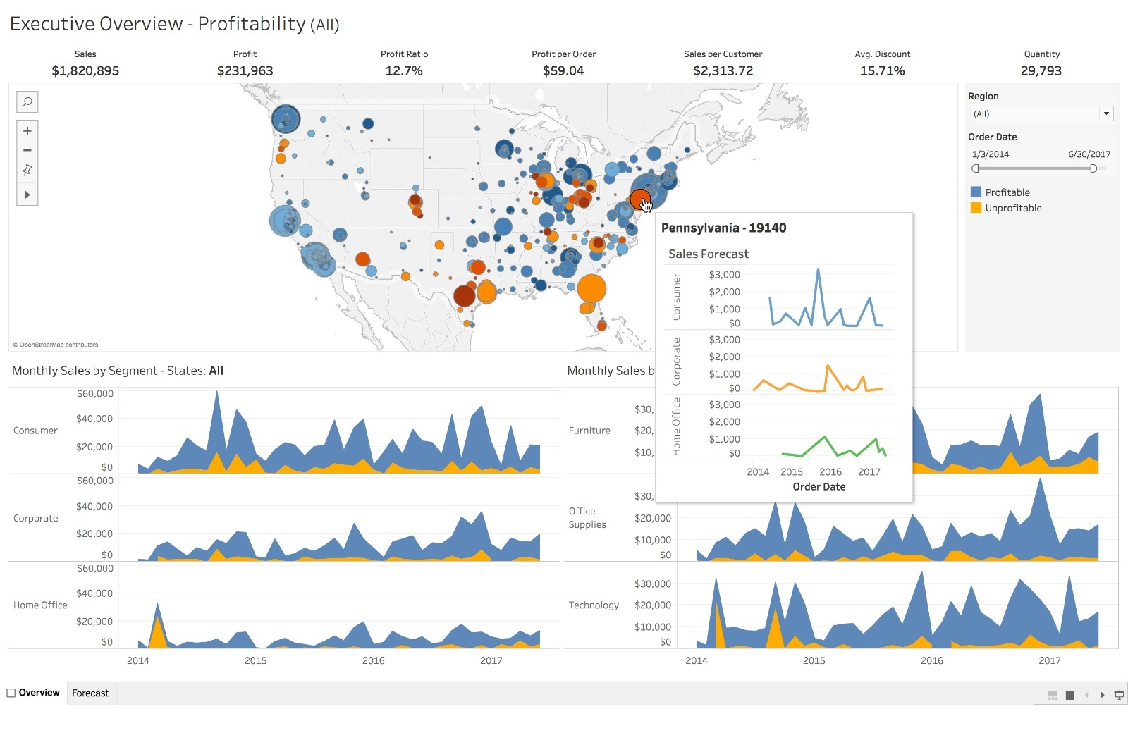
Visualization Terms
Data visualization:
The practice of translating information into a visual context, such as a map or graph, to make data easier for the human brain to understand and pull insights from.
The main goal of data visualization is to make it easier to identify patterns, trends and outliers in large data sets.
Its tools such as charts help to see and get examples, patterns, and anomalies for the company’s data.
“A picture is worth a thousand words”.
Visually appealing charts that use good data but fail to highlight an issue or deliver a message are worthless.
Information visualization:
The way of interpreting gathered data into visual terms.
Its tools such as GIS and gapminder give an open method to see and comprehend knowledge.
Infographics:
Visual representations of data and information using graphics, pictures, text, maps, etc. This content is designed to be efficient, engaging and user-friendly.
If a well-designed graphic with a compelling narrative features inaccurate information, the result is unreliable and misleading.
Notes:
https://www.analyticsfordecisions.com/data-visualization-vs-information-visualization/#:~:text=Data%20visualization%20is%20for%20identifying,the%20aftereffect%20of%20such%20examinations.
https://data.humdata.org/dataviz-guide/design-principles/

Slide 4
VA Terms
Visual Analytics (VA) is the science of analytical reasoning facilitated by interactive visual interfaces. (Thomas&Cook, 2005)
VA combines automated Visual analytics combines automated analysis with interactive visualizations analysis techniques with interactive visualizations for an effective understanding, reasoning and decision making on the basis of very large and complex datasets. (Keim et al., 2010)
VA: Humans + Machines
VA: More of an umbrella notion
Combines multiple areas or disciplines
Ultimately about using data and currency in tools to improve our knowledge and help make decisions
Analytics:
information resulting from the systematic analysis of data or statistics
the patterns and other meaningful information gathered from the analysis of data
Visual:
relating to seeing or sight
Visual Analytics:
?

Slide 5
Multidisciplinary field with four focus areas (Thomas&Cook, 2005)
Analytical reasoning techniques that enable users to obtain deep insights that directly support assessment, planning, and decision making
Visual representations and interaction techniques that take advantage of the human eye’s broad bandwidth pathway into the mind to allow users to see, explore, and understand large amounts of information at once
Data representations and transformations that convert all types of conflicting and dynamic data in ways that support visualization and analysis
Techniques to support production, presentation, and dissemination of the results of an analysis to communicate info in the appropriate context to varied audiences

Slide 6
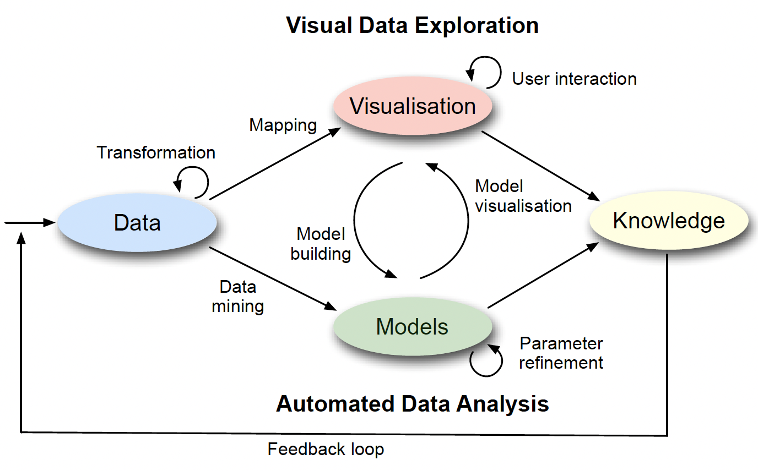
Visual Analytics Process by Keim
The visual analytics process is characterised through interaction between data, visualisations, models about the data, and the users in order to discover knowledge (Keim et al. 2010)
More: cognitive/make-sensing process etc.

Slide 7
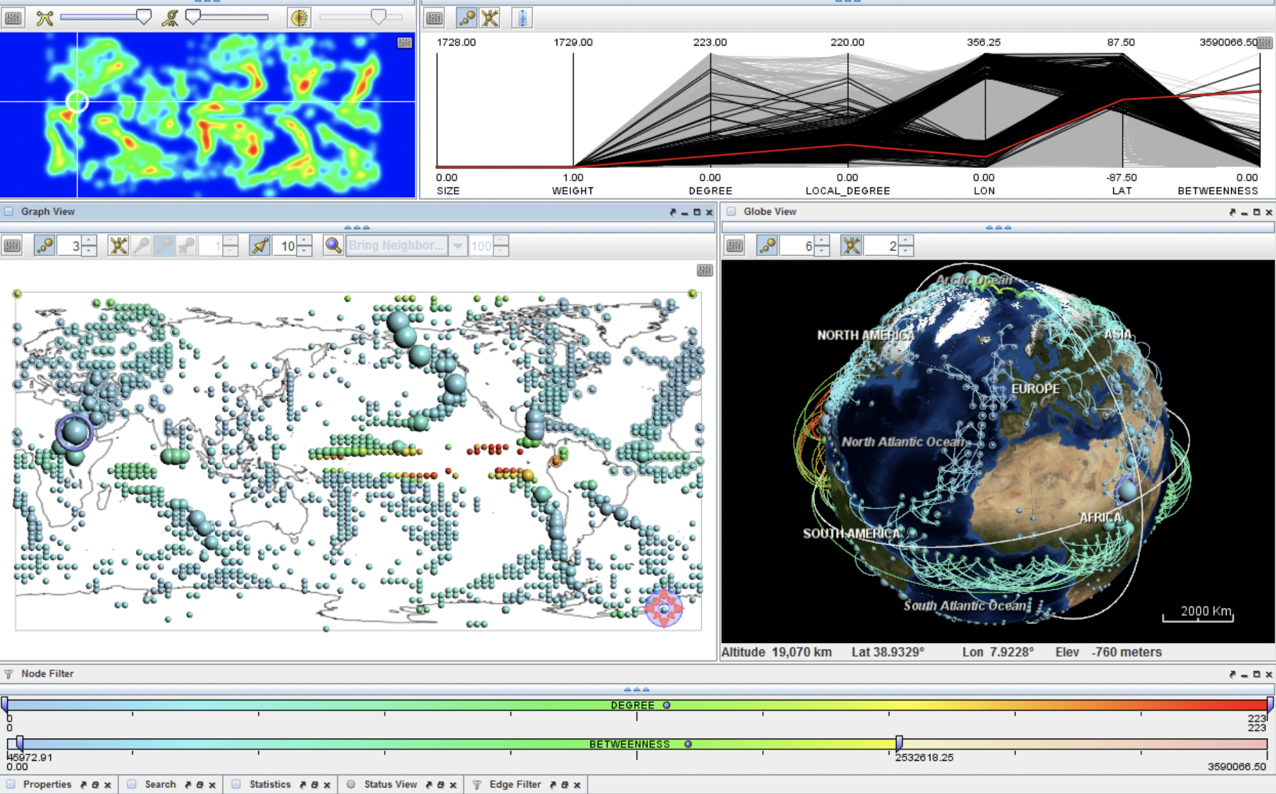
Focus areas (Keim et al. 2010)
VA is the creation of tools and techniques to enable people to:
Synthesise information and derive insight from massive, dynamic, ambiguous, and often conflicting data.
Detect the expected and discover the unexpected.
Provide timely, defensible, and understandable assessments.
Communicate these assessment effectively for action.

Slide 8
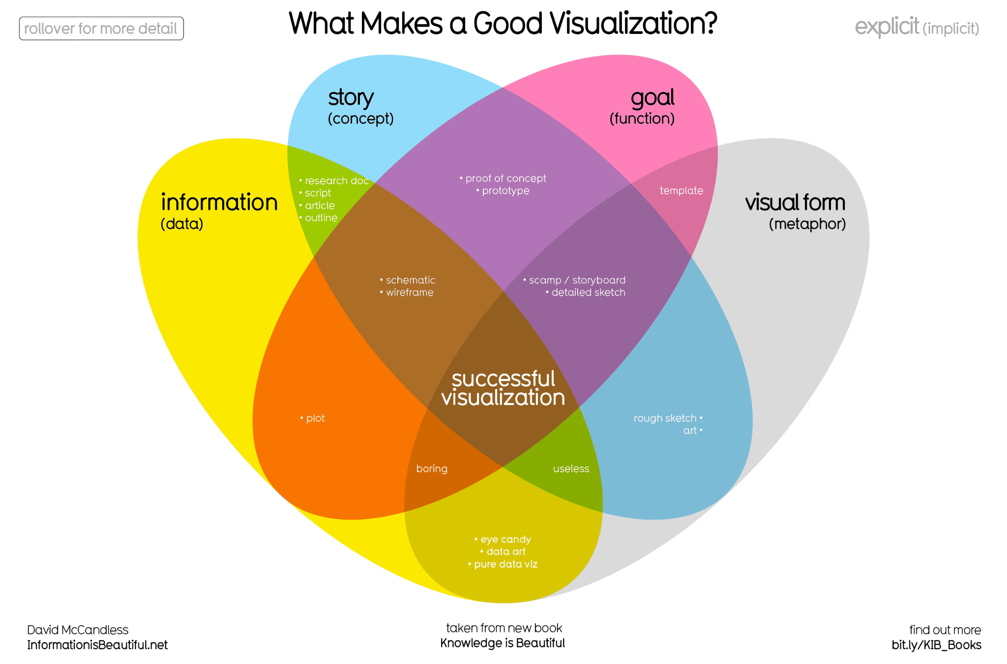

Slide 9
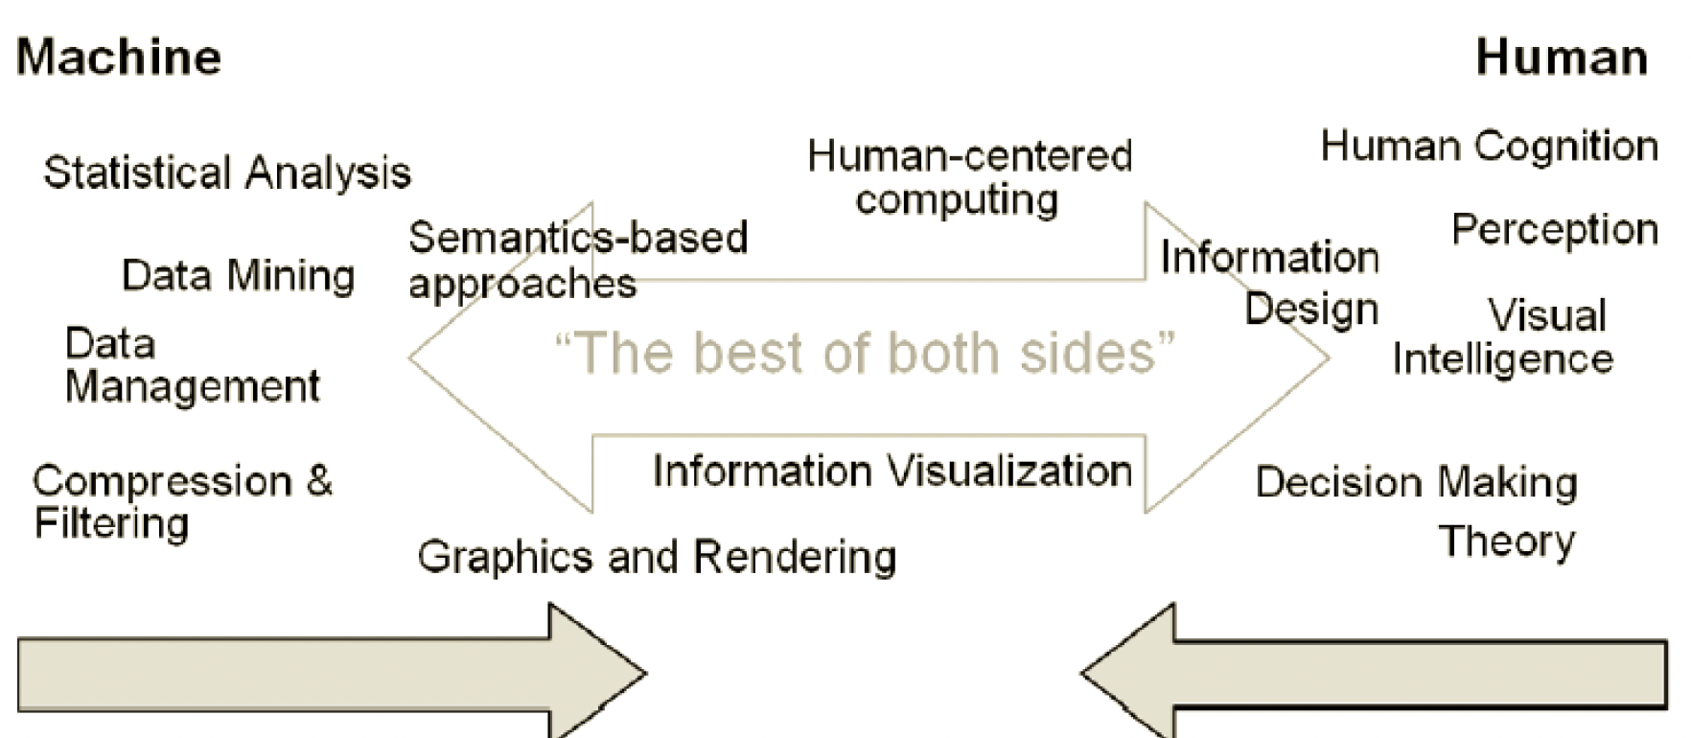
Keim’s Components

Slide 10
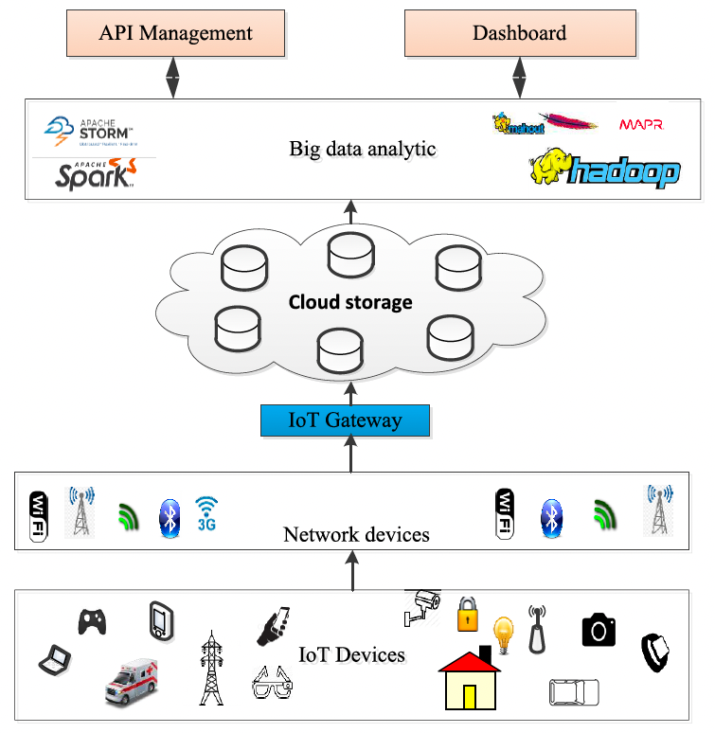
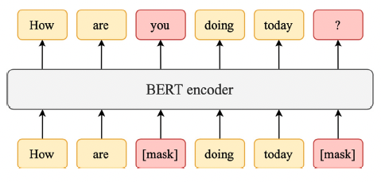
Since 2010, rapid developments in …
DS
ML
Deep Learning
Text/NLP

Slide 11
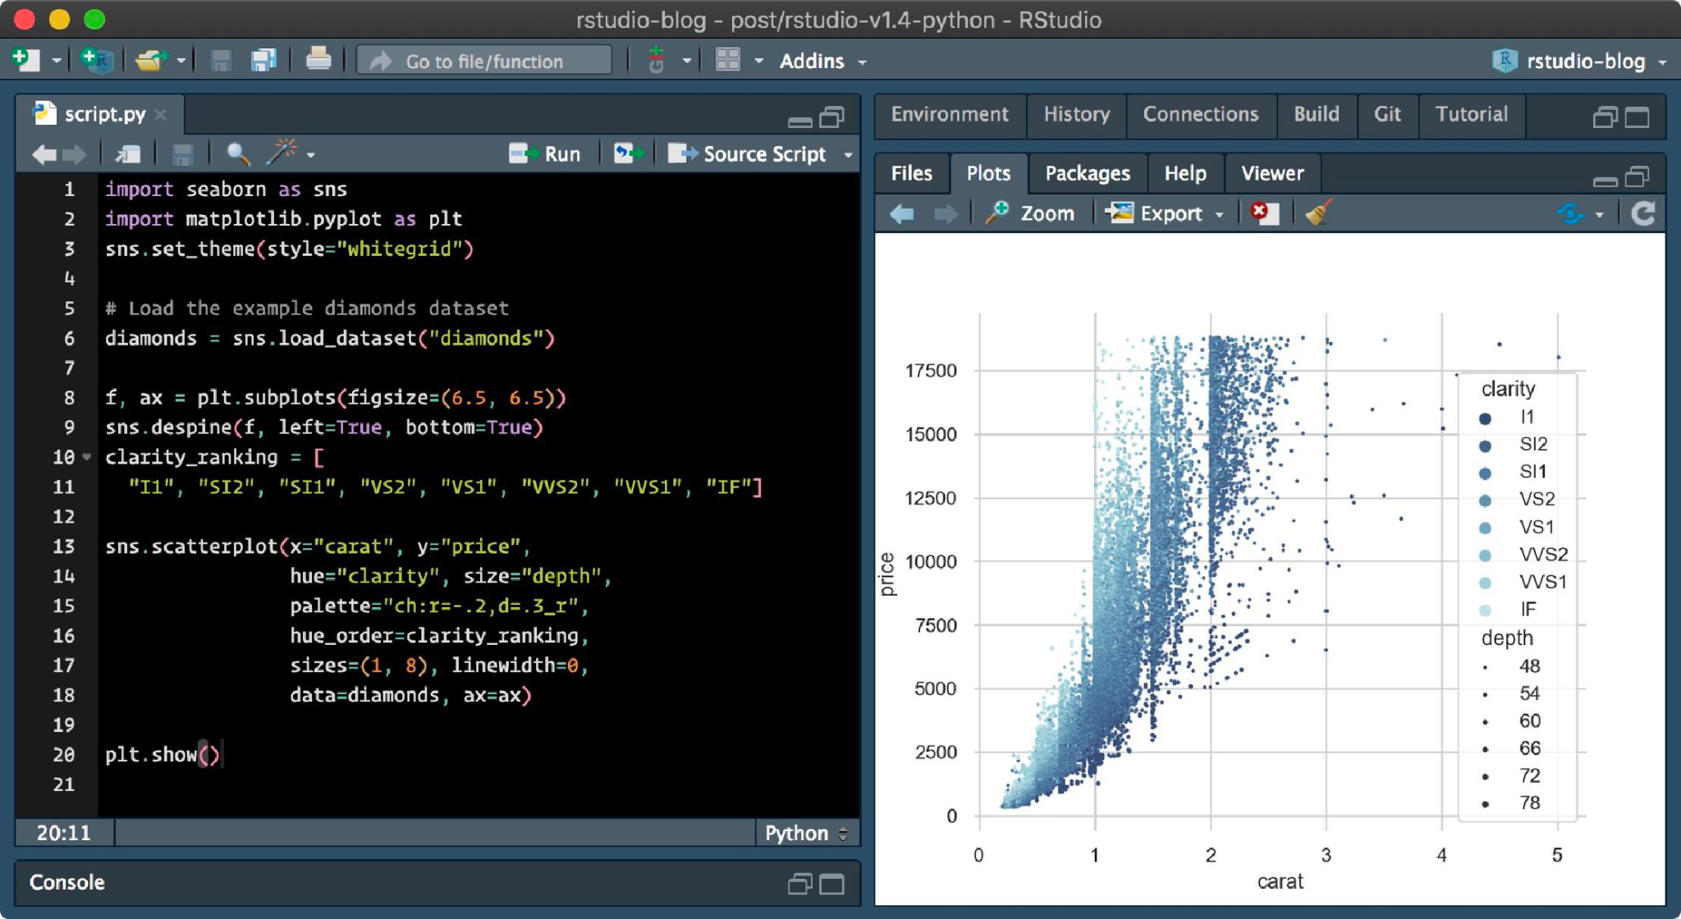
Components
Exploration, exploitation, storytelling, relationship discovery
Interact: Interactive interface of visualization, not static design. Select, reconfigure, pan, brush, dig, connect
Software
Big data, multiple data types handling: scaling,
Data Mining/Machine Learning employed: grouping, data reduction, outlier detection, DL
Combine strengths of both human and machine/electronic data processing
More…
WHAT IS THE MOST POPULAR DATA VISUALIZATION SOFTWARE as of 2022?
Not R
Notes:
Tableau
Python Plotly
Oracle OBIEE
Microsoft PowerBI
SAS Visual Analytics
Watson

Slide 12
Challenges in VA: ?

Slide 13
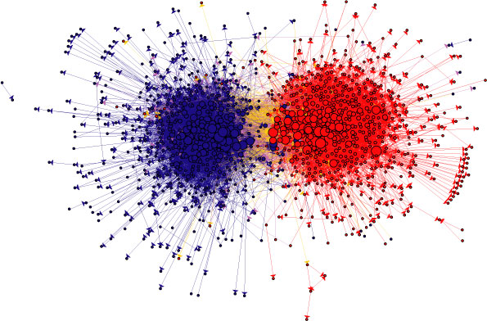
Visualization of political blogs

Slide 14
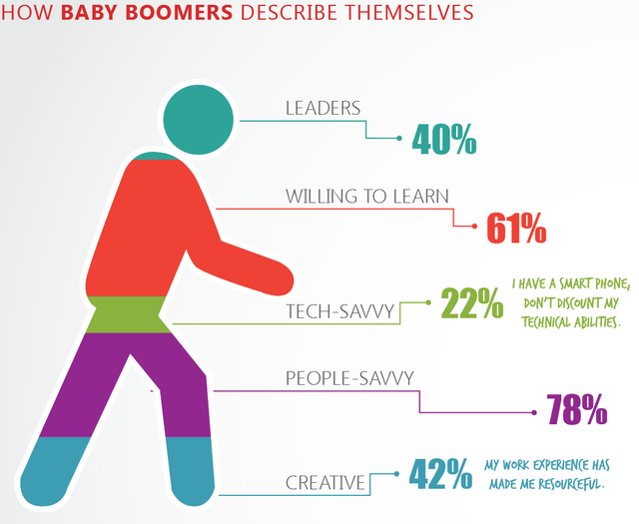
Bad visualization about baby boomers

Slide 15
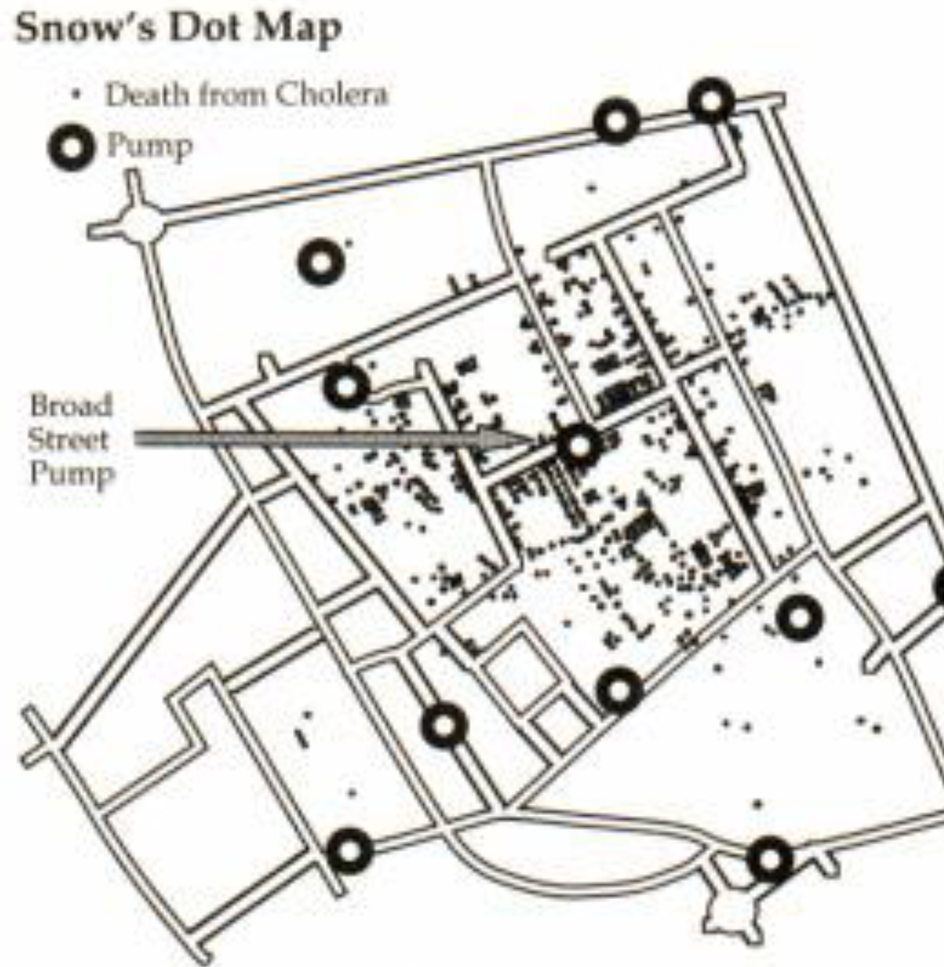
Snow’s Dot Map in 1854

Slide 16
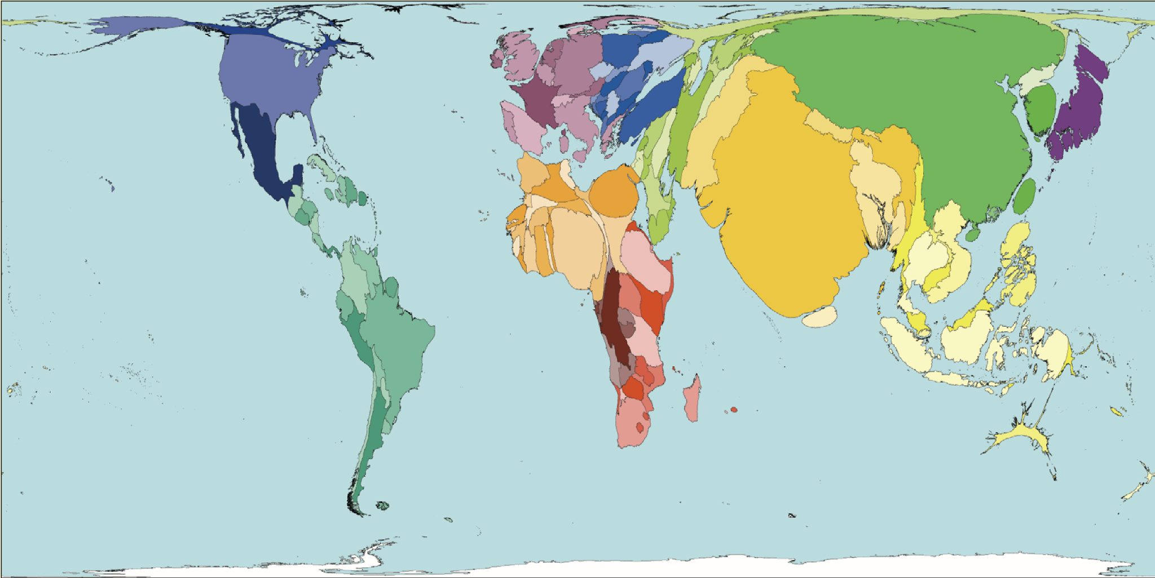
Cartogram of World Population, 2000

Slide 17
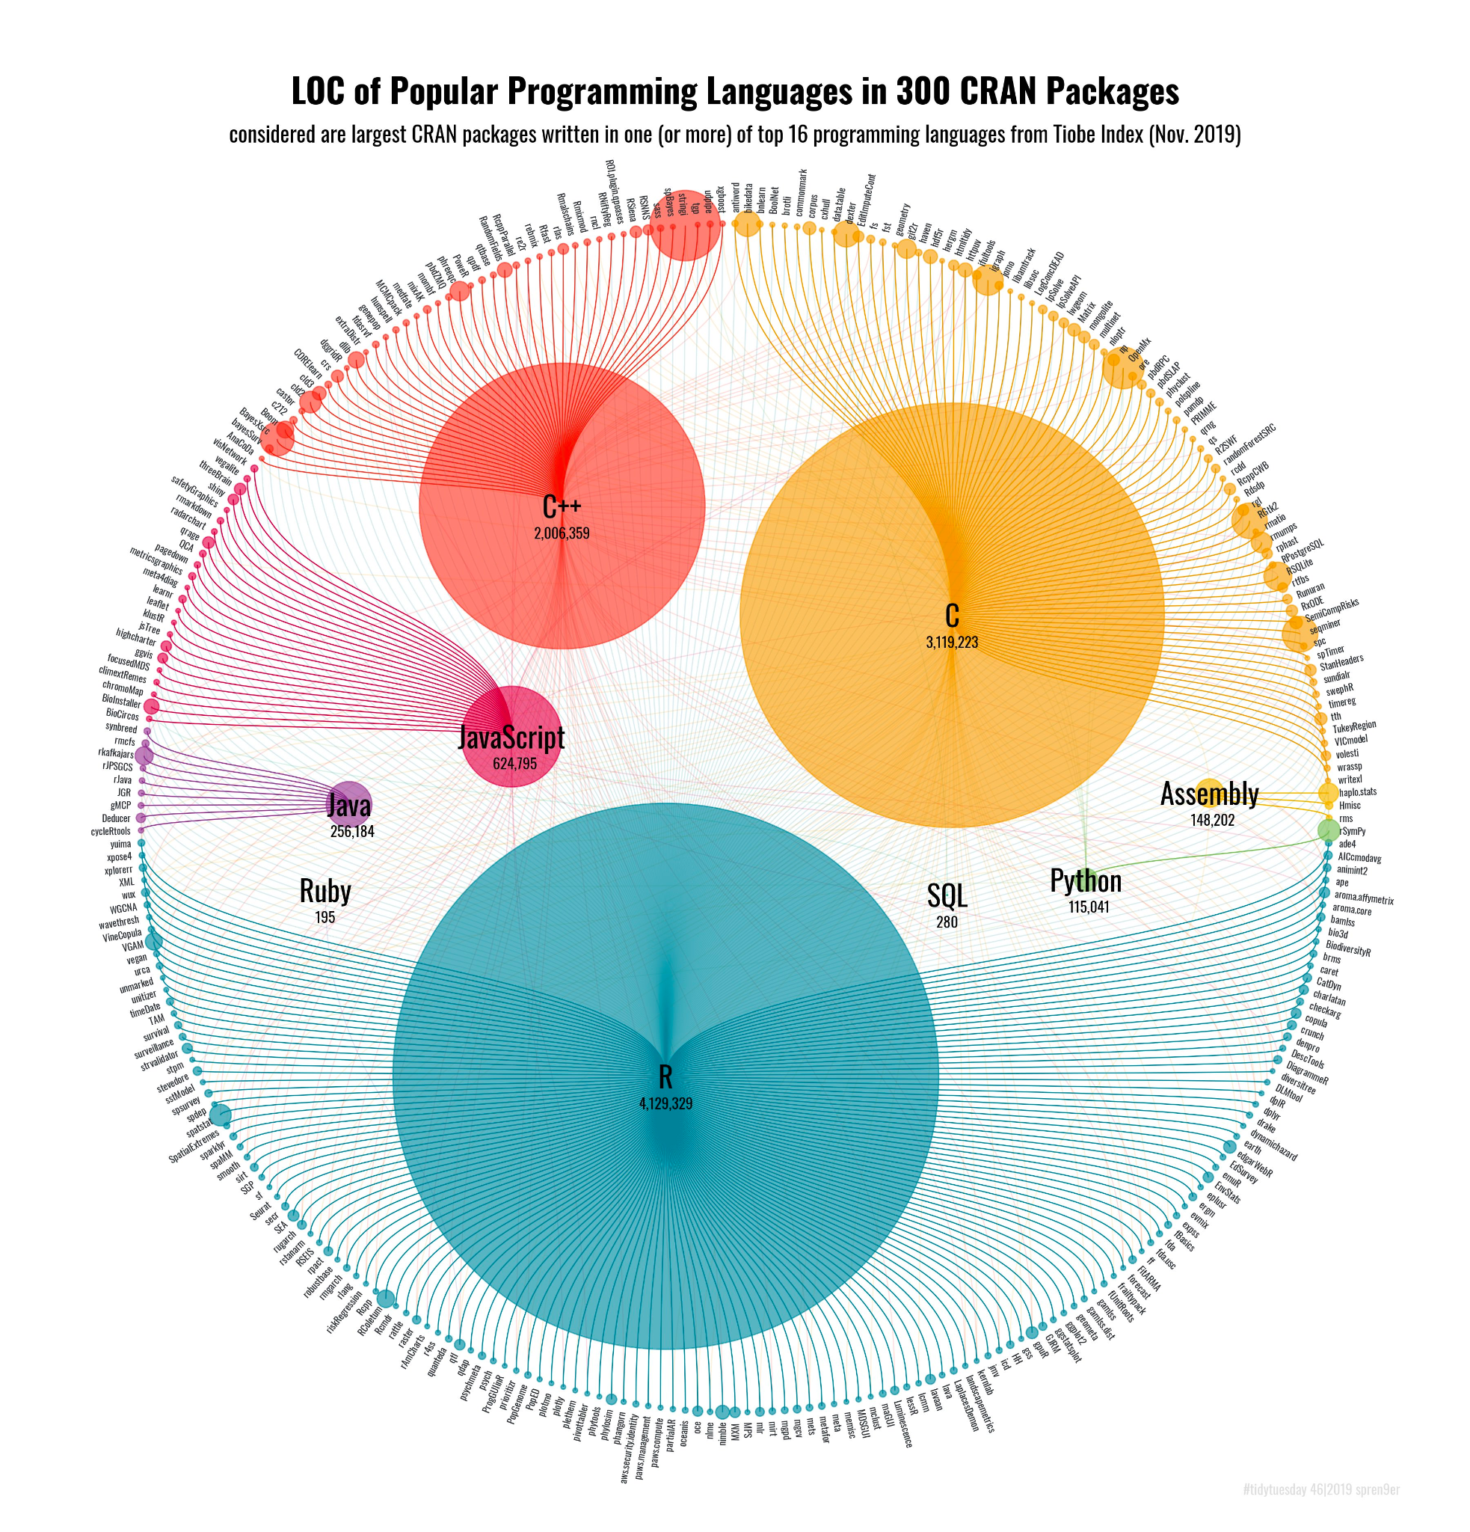
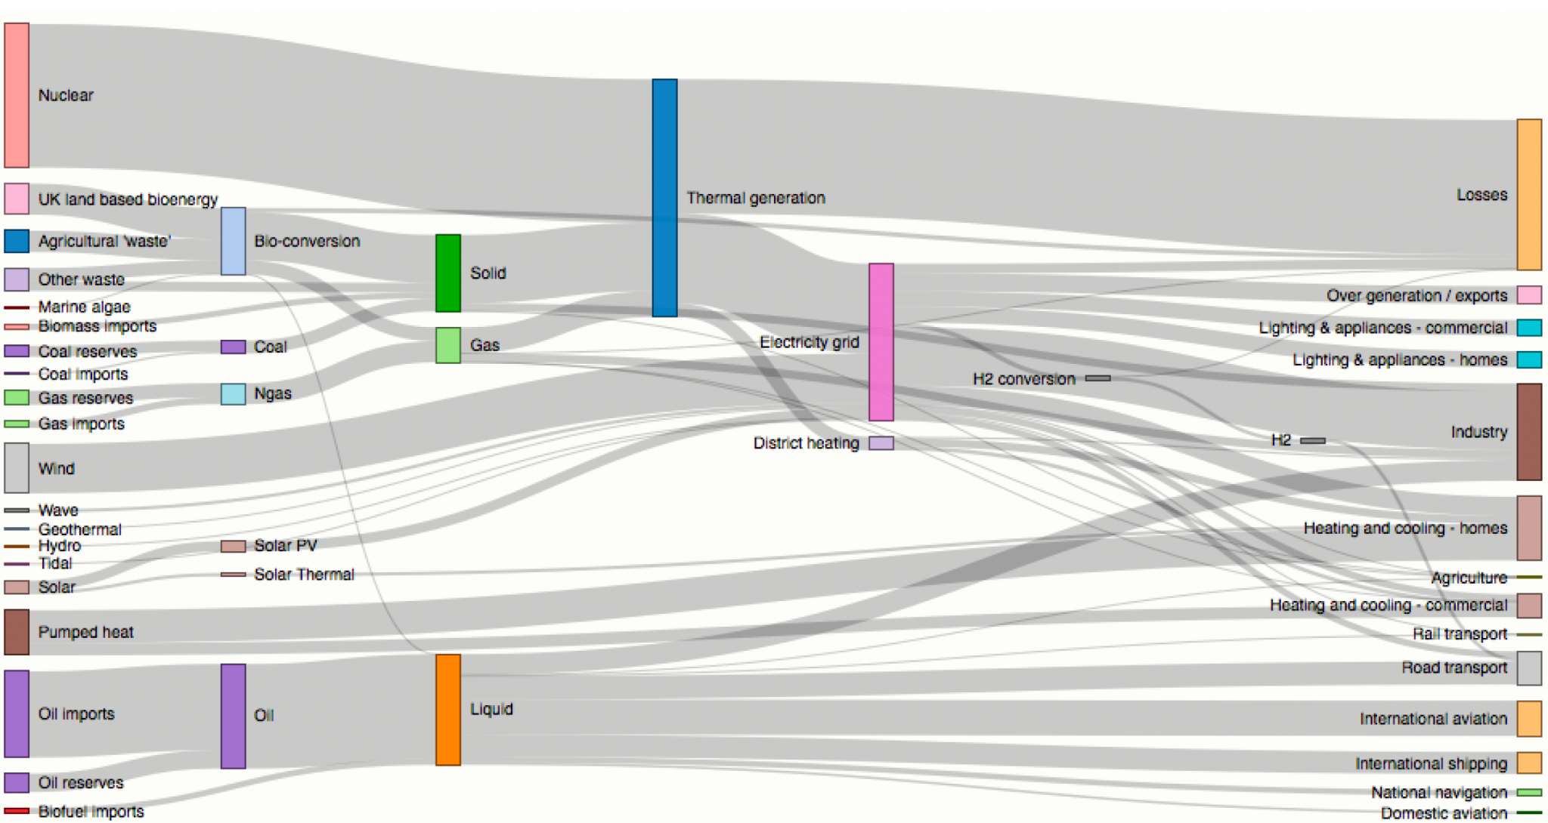
Chord diagram of programming languages used in CRAN
Sankey diagram

Slide 18
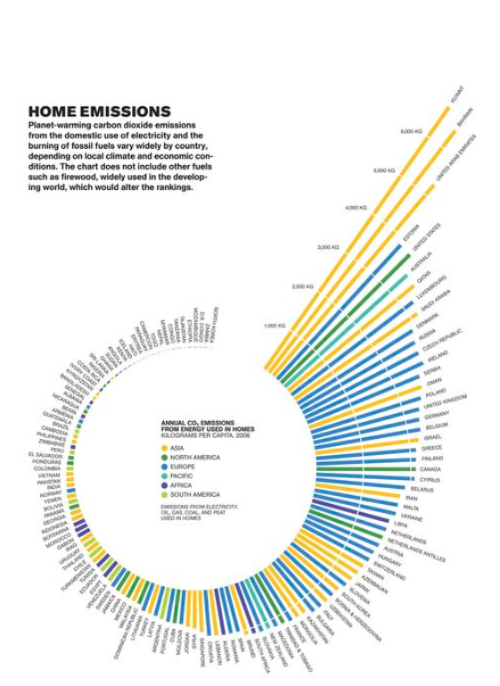
Coiled bar chart of CO2 emissions

Slide 19
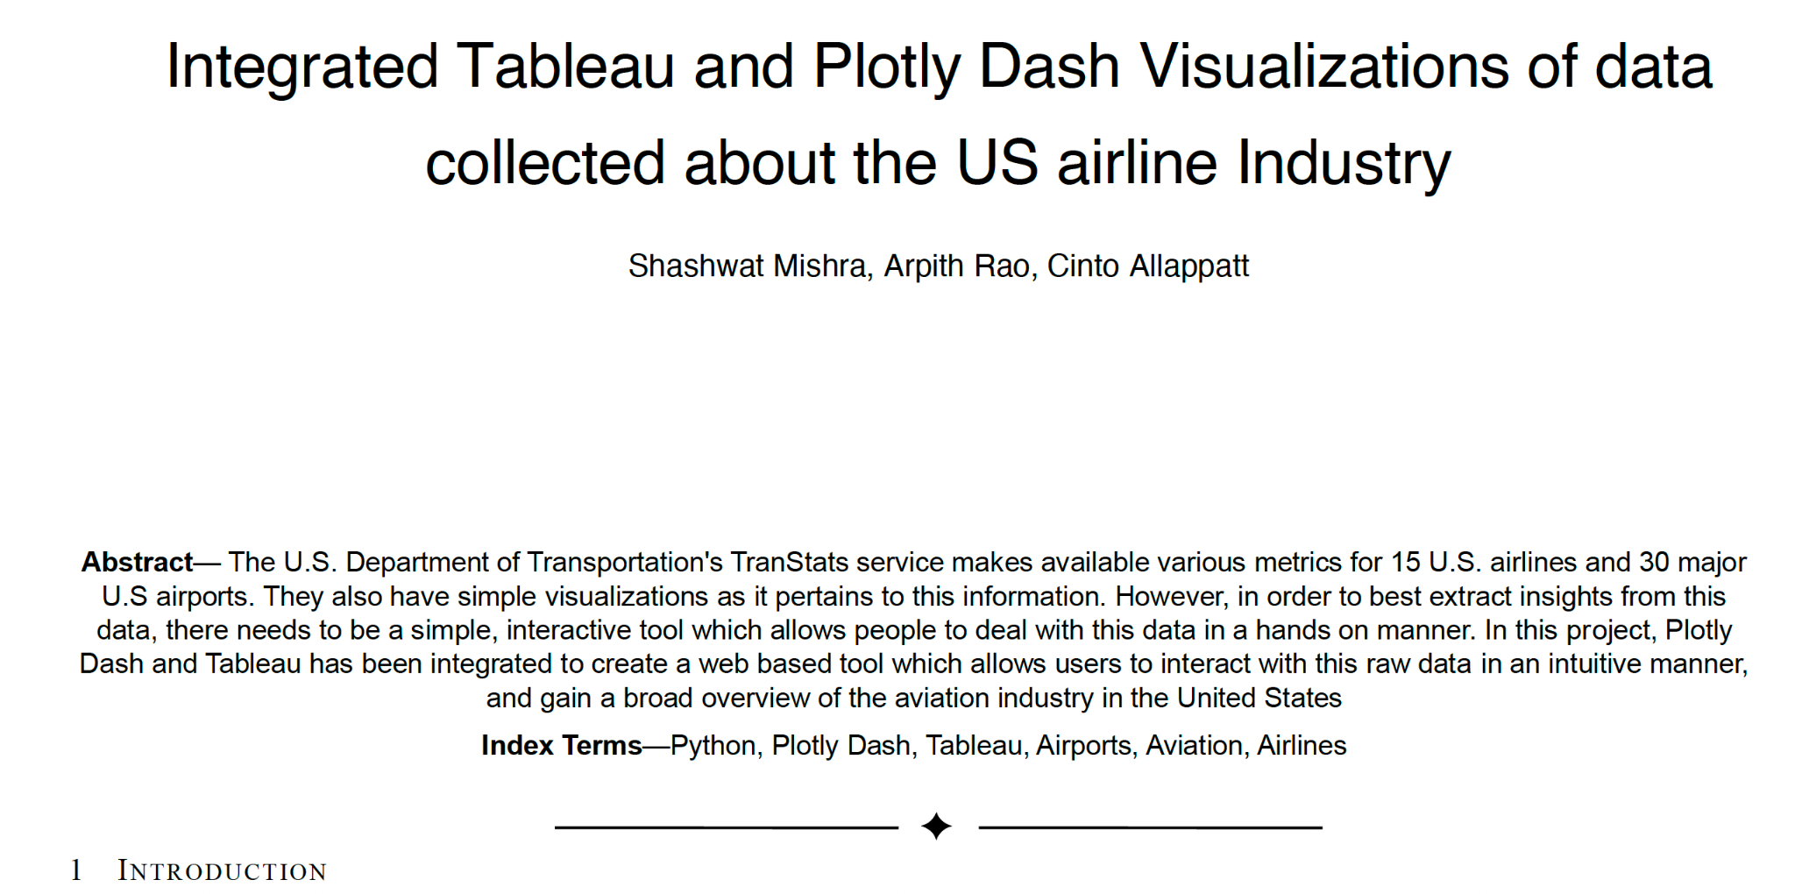
Fall 2022 Final Project Student Products
See the six papers from pdf posted under Final Project Samples
Just one of them

Slide 20
Interactive visualizations
Tableau
“The Tableau platform is known for taking any kind of data from almost any system, and turning it into actionable insights with speed and ease”
https://public.tableau.com/en-us/s/resources
https://public.tableau.com/app/discover
https://public.tableau.com/app/profile/addis.ashenafi/viz/Bikesharing-Dashboard/NYCBikesharingData
Python Plotly & Dash Plotly
https://plotly.com/python/
https://dash.gallery/Portal/
https://dash.gallery/self-driving/
QGIS, RShiny, Integration?
Data Mining/DS supported tools
SAS VA https://communities.sas.com/t5/SAS-Visual-Analytics-Gallery/tkb-p/vagallery https://www.sas.com/en_us/software/visual-analytics/demo.html

Slide 21
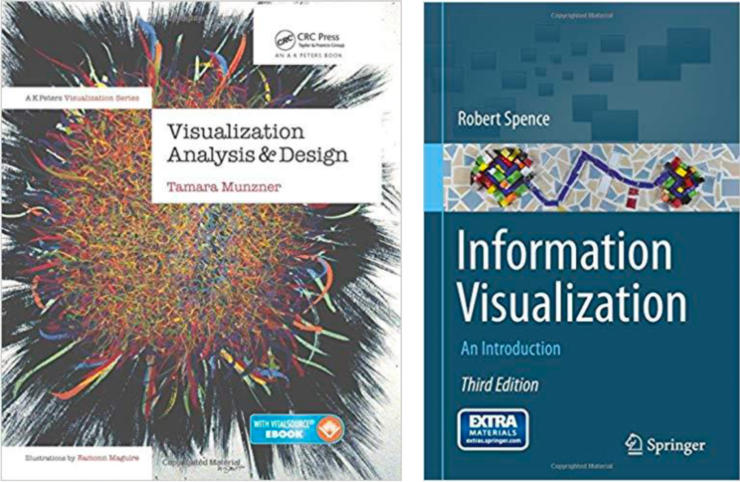
From Robin De Croon’s slide: Two books

Slide 22
ASA's stance on VA - BONUS

